Slide 1
HMIS Advisory
Committee Meeting
Central Florida Commission on Homelessness (CFCH)
CoC FL-507
Nov 29th, 2022
Wyatt Haro, Committee Chair
Notes:
Call to order: Wyatt -All in attendance verify name, add agency
Next slide: Wyatt (agenda)

Slide 2
HMIS Advisory Committee Mission
HMIS Advisory Committee Purpose
Our mission is to effectively use data, which includes inputs from those in need of services, those providing services, and from members of the community, to eliminate homelessness in Central Florida.
Oversee the CoC’s implementation of HMIS, what we do with the data and how we use it.
Notes:
Presenter: Wyatt
Next Slide: Wyatt

Slide 3
HMIS Advisory Committee
Chair | Wyatt Haro | Miracle of Love
Vice Chair | Vacant
Secretary/Recorder | Vacant
Voting Member | Brad Sefter | Health Care Center for the Homeless
Voting Member | Latoya Sheffield | Wayne Densch
Voting Member | Danielle Landaal | IDignity
Voting Member | Vacant
Voting Member | Vacant
HMIS Team Liaison | Brittney Behr | HSN - HMIS Project Coordinator
Notes:
Presenter: Wyatt -Committee Roll Call -July Minutes Roll Call Vote (Meeting Minutes - HMIS Advisory Committee 2022-07-12 (hmiscfl.org))
Next Slide: Wyatt (Agenda Roll Call)

Slide 4
Agenda
Call to Order
Committee Roll Call
Roll Call Vote - Minutes from Sept 2022
Roll Call Vote - Agenda for Nov 29th, 2022
HMIS Team Reports:
  Data Quality Plan - FY22-23
  Reporting Season Update - LSA and SPMs
  SSOM Progress
  HMIS Training and DQMs
New Survey - Feedback Requested
Feature Spotlight: Auto-Exit Functionality
COMMITTEE VOTE - All motions before committee
Notes:
Presenter: Wyatt -Agenda Roll Call Vote
Next: Wyatt

Slide 5
Officer Reports
Data Quality Plan - Ashley Brozenske
Reporting Season Update - Brittney Behr
SSOM Progress - Angel Jones
HMIS Training and DQMs - Racquel McGlashen
Notes:
Presenter: Wyatt
Next Slide: Tino

Slide 6
Data Quality Plan 2022-2023 Highlights
October 1, 2022 - September 30, 2023
Adding Coordinated Entry (CE) and Support Services (SSO) Projects
Adding Inactive Records (Current Living Situation updates) to Street Outreach (SO)
Adding Enrollment Length to Emergency Shelter (ES)
Removed Domestic Violence metric from all project types
Updating Benchmarks for ES and SO to include new metrics
Creating new Benchmarks for CE and SSO
Creating tailored Score Weighting for all project types
Notes:
Presenter: Tino
Next Slide: Tino

Slide 7
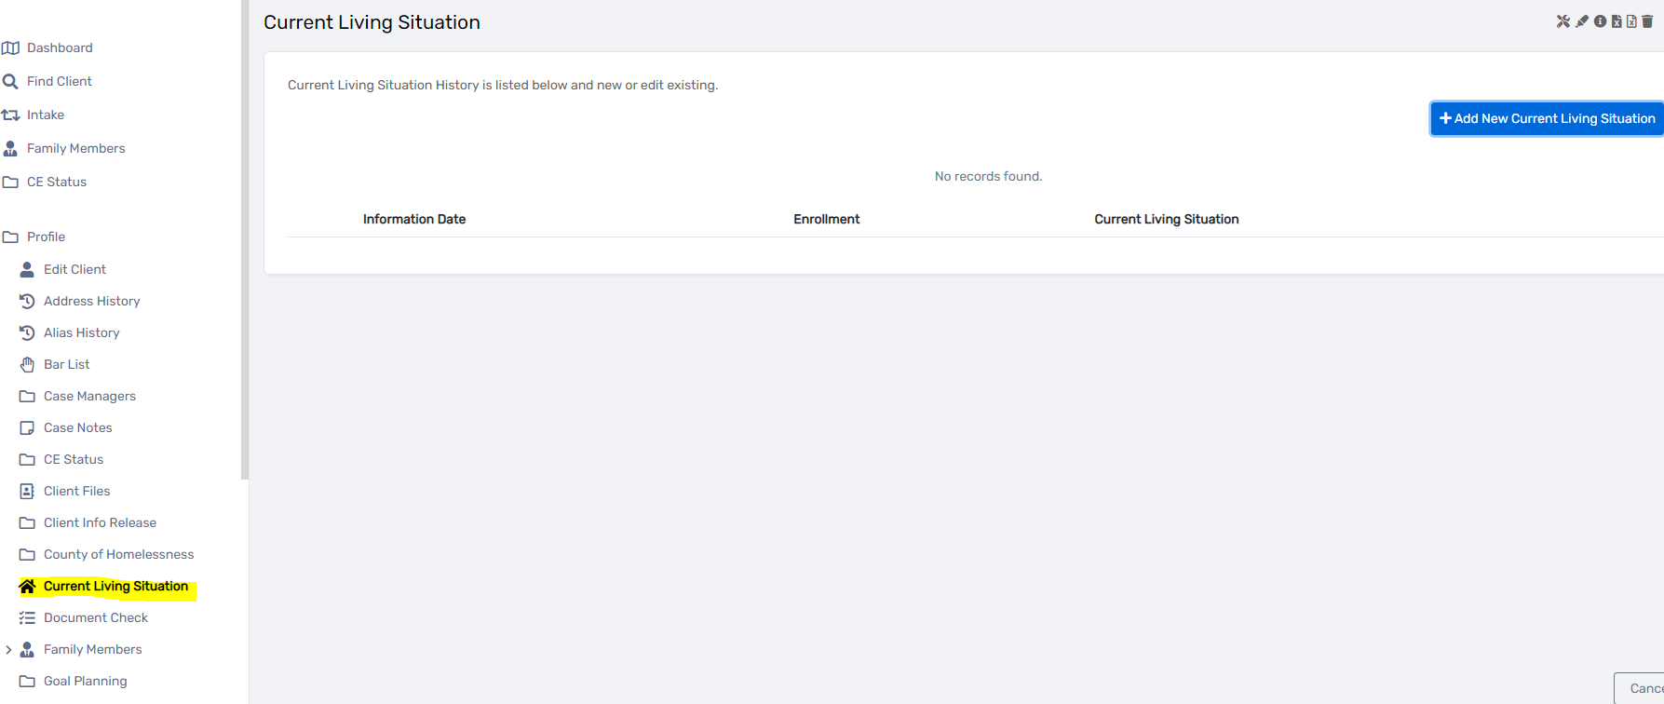
Inactive Records (Current Living Situation Updates)
For Street Outreach ONLY - Current Living Situation MUST be updated every 90 days for actively enrolled clients.
If no update, client must be exited
Records missing Current Living Situation updates are considered inactive records
Question 6f on the APR shows inactive records
Notes:
Presenter: Tino
Next Slide: Tino

Slide 8
Enrollment Length
For Emergency Shelter ONLY - Enrollment Length is the number of days the client has been enrolled in the project
Should be no longer than 180 days for Emergency Shelter (proposed)
Error rate is calculated by
# of Enrollments greater than 180 days
Total Enrollments
Notes:
Presenter: Tino
Next Slide: Tino

Slide 9
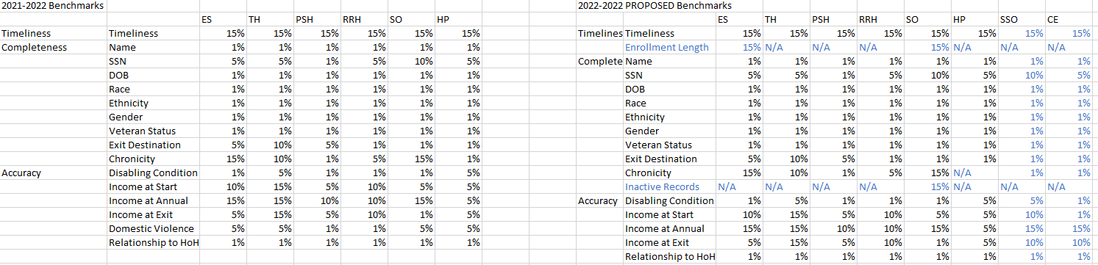
Proposed Benchmarks
Benchmarks assign the allowable error percentage for data quality element
Error percentages exceeding Benchmark values are considered failure
Benchmarks are staying the same except for new additions (proposed)
Notes:
Presenter: Tino
Next Slide: Tino

Slide 10
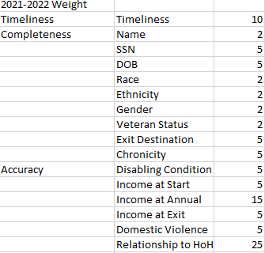
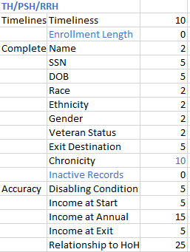
Score Weighting
Score Weights define how much (%) of the grade is assigned to each data point.
Stayed the same as 2021-2022 DQP for TH, PSH, and RRH with the exception of the removal of DV data point (added to Chronicity)
Notes:
Presenter: Tino
Next Slide: Tino

Slide 11
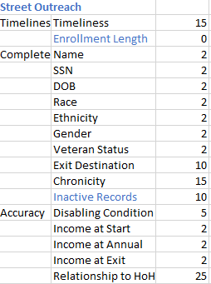
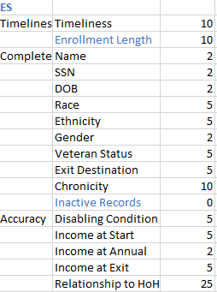
Score Weighting
New proposed Score Weighting for SO and ES add new data points for Inactive Records (SO) and Enrollment Length (ES)
Notes:
Presenter: Tino
Next Slide: Tino

Slide 12
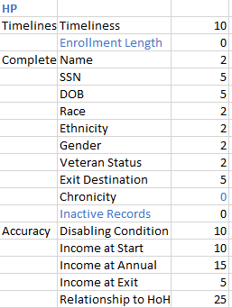
Score Weighting
New proposed Score Weighting for HP removes Chronicity (not evaluated for non-homeless clients)
Notes:
Presenter: Tino
Next Slide: Tino

Slide 13
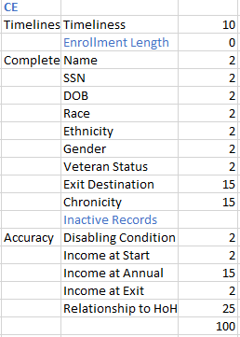
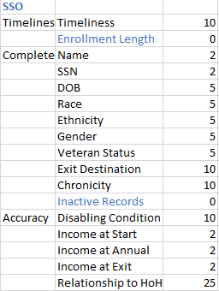
Score Weighting
New proposed Score Weighting for CE and SSO (new to DQP)
Notes:
Presenter: Tino
Next Slide: Brittney

Slide 14
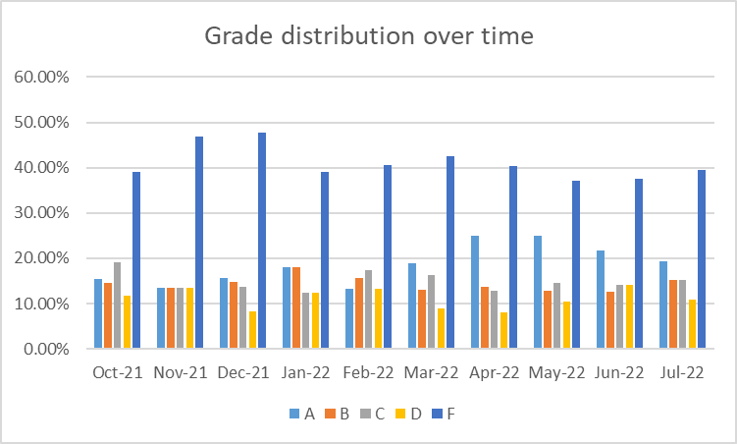
Data Quality Workgroup
Grades over time show gradual decrease in F’s and increase in A’s
Don’t forget to complete Annual Assessments!
Notes:
Presenter: Ashley -Yield time to Chair
Next Slide: Racquel

Slide 15
HMIS Reporting Season 2023
It’s that magical time of year again!
The first quarter of the calendar year has a lot of important HUD reporting deadlines. During this time, we will be reaching out to organizations to correct and update data. We encourage you to reach out to the Helpdesk if you need any support during this process.
We greatly appreciate your efforts to help us ensure accurate reporting. Thank you!
1/13/2023
Longitudinal Systems Analysis (LSA)
The LSA includes a 3-year lookback of system-level data that can be filtered by demographics and system pathways. It gives a high-level understanding of a system’s response to homelessness. Stella-P uses LSA data to generate charts. View last year’s submission here on our website)
2/28/2023
System Performance Measures (SPMs)
SPMs are a series of 6 metrics used to evaluate effectiveness of a homeless response system. SPMs include: length of time homeless, first-time homeless, total homeless, exits to permanent housing, returns to homelessness, and income growth. View last year’s submission here on our website
TBD - April 2023
Point-in-Time Count (PIT)
The PIT count is an annual survey of people experiencing homelessness in our service area on a single night (the actual count can be performed over multiple days). PIT data includes people in emergency shelters and transitional housing, as well as people engaged on the streets or in another unsheltered location. View last year;s submission here on our website
TBD - April 2023
Housing Inventory Chart (HIC)
The HIC is a count of inventory for projects that provide housing or lodging, including ES, TH, RRH, PSH and OPH projects. This is used along with the PIT to determine utilization of a homeless response systems dedicated resources. This data is updated once a year prior to submitting. View last year’s submission here on our website
Notes:
Presenter: Brittney
Next Slide: Brittney

Slide 16
How You Can Help
Run an APR (with drill-down) to find and correct the following errors…
  Relationship to Head of Household
  Date of Birth
  Gender
  Race
  Ethnicity
  Enrollments over 365 days - possible missed exits
  Exit Destination
Notes:
Presenter: Brittney
Next Slide: Angel

Slide 17
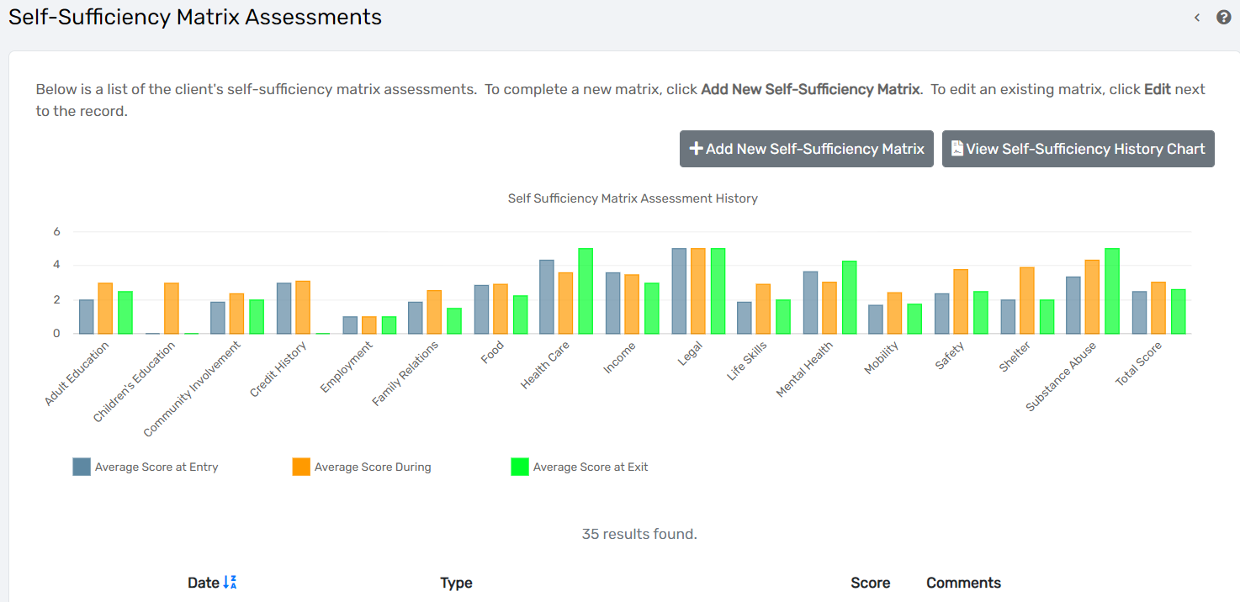
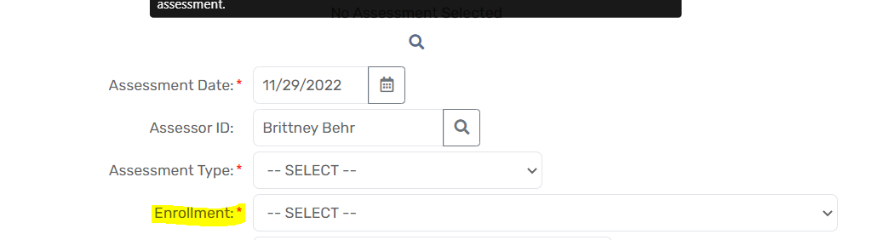
SSOM Progress Update
On 11/28/2022, Eccovia completed the upload of Self-Sufficiency Matrix data into ClientTrack
We added an Enrollment field to the assessment
FUTURE PLANS - Add a way to filter the SSOM chart by Organization
Notes:
Presenter: Angel
Next Slide: Rocky/Angel

Slide 18

HMIS Data Quality Monitoring
What to expect?
Data Quality Monitors Scheduled for 2022
  Communicated via agency liaisons
  Primarily focuses on the CoC APR
  We are looking at Q4 for FY21-22 (July - Sept)
  Supportive Service Only (SSO) project will now be reviewed as well.
Recommendations for improvements and a timeline for addressing data quality issues
Follow up with a scorecard (grading system)
If you have not scheduled your last one for this year, please do so with this link and select a date between now and Dec 22nd: https://calendly.com/hmisfl507/hmis-dq-monitor
Interested in sitting in on a DQM? Let us know at hmis@hsncfl.org!
Notes:
Presenter: Racquel
Next Slide: Racquel

Slide 19
HMIS Training & Support
Our routine monthly training calendar:
1st & 3rd Tuesday: HMIS 101 New User Training (9a - 2p)
2nd & 4th Wednesday: HMIS 101/102 Refreshers (2p - 4p)
1st & 3rd Tuesday: ClientTrack Introduction to Reports Training (3p - 4:30p)
Data Quality Workshops are now on the calendar as well!
Monthly Sessions: 2nd & 4th Thursdays - 2nd (10a - 11:30a) & 4th (1:30p - 3p)
* Additional training sessions may be requested as needed.
Join us for our office hours M/W from 1p - 2p for additional one-on-one HMIS support.
Reminders:
All new user training requests must come through the Agency Liaison.
Agency Liaison needs to let the HMIS team know ASAP when someone leaves
the agency so we can inactivate accounts. This is to protect the system and keep an accurate count of available subscriptions for assignment.
Notes:
Presenter: Racquel
Next Slide: Racquel

Slide 20
HMIS Training Announcement
We have a new training model coming to the community soon!
The HMIS Team has been working to create a full HMIS 101 training model that can be completed entirely in HSN University.
What does this mean for your organization?
Convenience with scheduling training for your staff
  No longer have to wait until the 1st and 3rd Tuesday to complete the HMIS 101 New User training.
Background support still available
  1st and 3rd Tuesdays, we will still run the zoom session from 9a - 2p for trainees to pop in for support. Refresher sessions and Mon/Wed support hours can also be used for training support.
Trainees still expected to demonstrate understanding of various workflows in the training site.
  To gain access: all assigned modules must be completed, there will be a review of the demo client in the training site, and the user agreement must be signed/submitted.
Notes:
Presenter: Racquel
Next Slide: Wyatt

Slide 21
Survey Feedback
New HMIS Survey Questions
Notes:
Presenter: Wyatt
Next slide: Brittney

Slide 22
HMIS Survey
Goal: Provide users an opportunity to give feedback on training, helpdesk support, the software transition, and ClientTrack features anonymously.
Are there other topics we should include in the survey? What would you want to provide feedback on?
Would a Google Form survey prevent certain users from participating?
We want to include a question about roles: is this list comprehensive of the different roles in our community? (Note: Agency Liaison as a role will be a separate question)
  Case Manager
  Executive Leadership
  Program Manager
  Administrative Support Staff
  Volunteer
  Grant/Reporting Manager
  Data Entry Specialist
  Other (comment box)
Notes:
Presenter: Brittney
Next Slide: Brittney

Slide 23
Feature Spotlight: Auto Exit Functionality
Notes:
Presenter: Brittney
Next slide: Brittney

Slide 24
Auto-Exit Functionality
Clienttrack includes a feature called “Auto-exit” that allows a project to automatically create an exit after a certain time-frame
  ex. 90 days after a service is entered, an Auto-exit creates an exit record on the same day
This feature is not recommended for projects that need high quality exit destination data, such as housing projects
This feature can be useful for drop-in center or supportive service projects to reduce data entry workload
This feature does not apply to older data - anyone entered prior to the auto-exit being enabled will need to be manually exited
Jan 1st
90 days
April 1st
Service Added
No Services Added
Auto-Exit Created
A service that the project identifies as a “participating service” is entered for the project.
In this example time-frame, no more services are entered for the project for 90 days.
An exit record is created by the system for the same date as the last “participating service”.
Notes:
Presenter: Brittney
Next Slide: Brittney

Slide 25
Auto-Exit Functionality
If a project would like to consult about auto-exits for their project:
  Submit a ticket to the Helpdesk to request a consultation
  Identify which project you would like an auto-exit for
  Identify which services are “participating services”:
    These services keep the record open when entered
    Services that are not a “participating service” will not keep the record open
    Exit date will be the same as the date of the last “participating service”
  Identify the time-frame, how many days should pass before the record is exited? (90 days recommended)
Submit a ticket: click the blue “support” button on www.hmiscfl.org or send an email to hmis@hsncfl.org
Notes:
Presenter: Brittney
Next Slide: Wyatt

Slide 26
Committee Roll-Call Vote
HMIS Committee Officers
Notes:
Presenter: Wyatt
Next Slide: Wyatt

Slide 27
Committee Roll-Call Vote
Any other motion before committee
Notes:
Presenter: Wyatt -Open to motions by committee members
Next Slide: Wyatt

Slide 28
HMIS Advisory Committee Nominees
Accepting nominations (from supervisors, liaisons, peers, and self)
  Email hmis-advisory@hsncfl.org
    Include
      Name
      Agency
      Role with HMIS
      How long you have worked in HMIS
      Contact Email
      Contact Telephone Number
      Brief Biography
Voting on nominations will be done virtually
Please be sure that any person nominated is able to commit time to the committee and is willing to participate
Notes:
Presenter: Wyatt
Next Slide: Wyatt

Slide 29
HSN HMIS Team
Angel Jones
HMIS Operations Manager
Agustin “Tino” Paz
HMIS Senior Data Analyst
Ashley Brozenske
HMIS Data Analyst I
Brittney Behr
HMIS Project Coordinator
Chuck Vroman
HMIS System Success Specialist
Racquel McGlashen
HMIS Partner Success Specialist
Tyler Claitt
HMIS Partner Support Specialist

Slide 30
Thank you for Attending!
Next meeting date:
Tuesday, Jan 10th, 2023
10:30 am to 12:00 pm
HMIS Guides, Documents, Training, Acronyms & More
hmiscfl.org
https://www.hmiscfl.org/training/datadefinitions/
Notes:
Wyatt Closes Meeting

