Slide 1
HMIS Advisory
Committee Meeting
Central Florida Commission on Homelessness (CFCH)
CoC FL-507
Sept 13th, 2022
Wyatt Haro, Committee Chair
Notes:
Call to order: Wyatt -All in attendance verify name, add agency
Next slide: Wyatt (agenda)

Slide 2
HMIS Advisory Committee Mission
HMIS Advisory Committee Purpose
Our mission is to effectively use data, which includes inputs from those in need of services, those providing services, and from members of the community, to eliminate homelessness in Central Florida.
Oversee the CoC’s implementation of HMIS, what we do with the data and how we use it.
Notes:
Presenter: Wyatt
Next Slide: Wyatt

Slide 3
HMIS Advisory Committee
Chair | Wyatt Haro | Miracle of Love
Vice Chair | Vacant
Secretary/Recorder | Vacant
Voting Member | Brad Sefter | Health Care Center for the Homeless
Voting Member | Latoya Sheffield | Wayne Densch
Voting Member | Danielle Landaal | IDignity
Voting Member | Vacant
Voting Member | Vacant
HMIS Team Liaison | Brittney Behr | HSN - HMIS Project Coordinator
Notes:
Presenter: Wyatt -Committee Roll Call -July Minutes Roll Call Vote (Meeting Minutes - HMIS Advisory Committee 2022-07-12 (hmiscfl.org))
Next Slide: Wyatt (Agenda Roll Call)

Slide 4
Agenda
Call to Order
Committee Roll Call
Roll Call Vote - Minutes from July 2022
Roll Call Vote - Agenda for September 13, 2022
HMIS Team Reports:
  CoC Project Type Benchmarks
  ROI and Procedures Updates
  Workgroup Updates
  HMIS Training and Reporting
Public Input: Motion to amend Committee Charter
Committee Debate: Motion to amend Committee Charter
Public Input: Caseload - HOH or Family
Committee Debate: Caseload - HOH or Family
Public Input: Record Delete Authorization
Committee Debate: Record Delete Authorization
COMMITTEE VOTE - All motions before committee
Notes:
Presenter: Wyatt -Agenda Roll Call Vote
Next: Wyatt

Slide 5
Officer Reports
CoC Project Type Benchmarks - Tino Paz
ROI and Procedures Update - Chuck Vroman
Workgroup Updates - Ashley Brozenske
HMIS Training and Reporting - Raquel McGlashen
Notes:
Presenter: Wyatt
Next Slide: Tino

Slide 6
CoC Project Type Benchmarks
Approved by CFCH Technical Expertise Committee
Each Project Type includes unique benchmarks
  Emergency Shelter (ES)
  Transitional Housing (TH)
  Street Outreach (SO)
  Permanent Supportive Housing (PSH)
  Rapid Re-Housing (RRO)
  Homelessness Prevention (HP)
  Coordinated Entry (CE)
Uses the System Performance Measures (SPM) and Annual Performance Report (APR) HUD standard reports
Benchmarks based on previous Fiscal Year performance
Notes:
Presenter: Tino
Next Slide: Tino

Slide 7
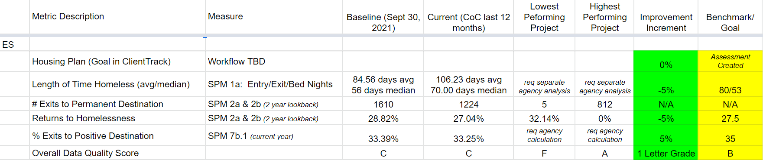
Benchmark Sample for ES
Notes:
Presenter: Tino -Yield time to Chair
Next slide: Chuck

Slide 8
ROI Procedure Update
ROI usage changed with our new software implementation.
Each agency only needs one ROI per client. You no longer need separate ROIs for each project.
The standard ROI is applicable for three years.
Client signature in ClientTrack replaces paper when practical.
ROI Paper copy is available here:
  https://www.hmiscfl.org/hmis-release-of-information-agreement/
Notes:
Presenter: Chuck
Next Slide: Chuck

Slide 9
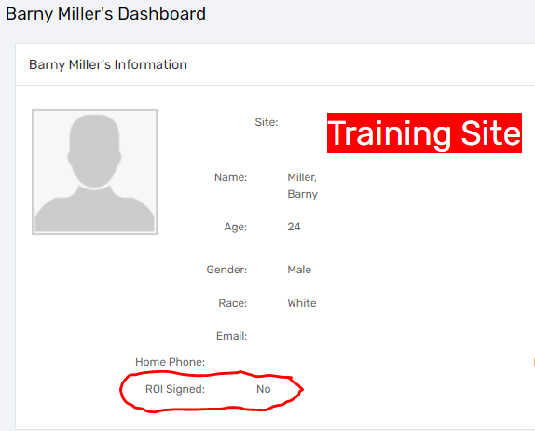
Incomplete Client ROI Example
This image shows a client without a signed ROI
Notes:
Presenter: Chuck
Next Slide: Chuck

Slide 10
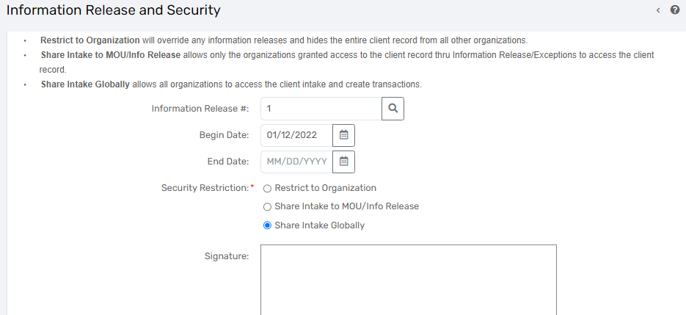
Incomplete Client ROI Example
Notes:
Presenter: Chuck
Next Slide: Chuck

Slide 11
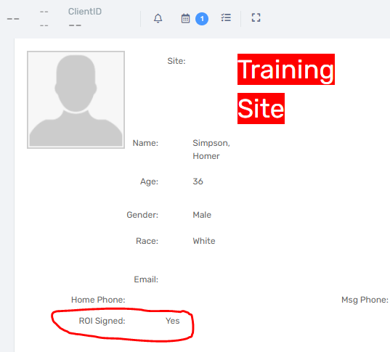
Client ROI Examples
This image shows a client with a signed ROI
Notes:
Presenter: Chuck
Next Slide: Chuck

Slide 12
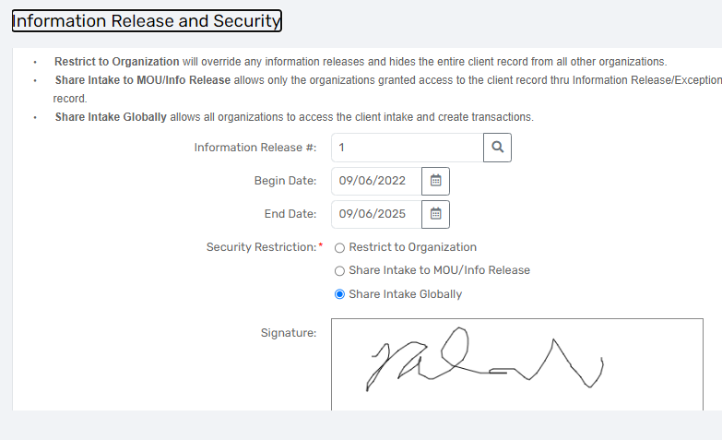
Client ROI Example
Notes:
Presenter: Chuck
Next Slide: Chuck

Slide 13
Client ROI Data Quality Tips
Do not change “Information Release #” field!
Do not set the start and end dates to the same date. If left as same date, client record becomes hidden.
If client refuses to share their data, submit a new ticket to the HMIS Helpdesk.
Notes:
Presenter: Chuck -Yield time to Chair
Next Slide: Ashley

Slide 14
Workgroup Updates
Notes:
Presenter: Ashley
Next Slide: Ashley

Slide 15
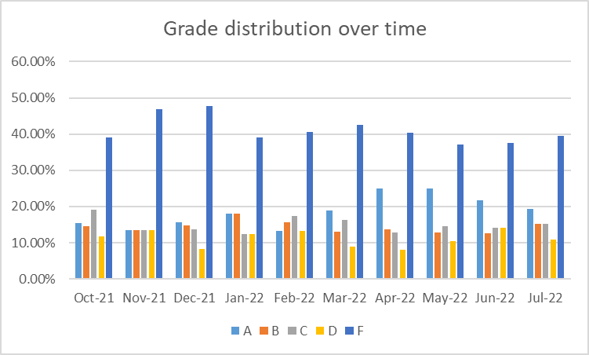
Data Quality Workgroup
Grades over time show gradual decrease in F’s and increase in A’s
Don’t forget to complete Annual Assessments!
Notes:
Presenter: Ashley -Yield time to Chair
Next Slide: Racquel

Slide 16
HMIS Training and Monitoring
Notes:
Presenter: Racquel
Next Slide: Racquel

Slide 17

HMIS Data Quality Monitoring
What to expect?
Data Quality Monitors Scheduled for 2022
    Communicated via agency liaisons
    Primarily focuses on the CoC APR
  Recommendations for improvements and a timeline for addressing data quality issues
  Follow up with a scorecard (grading system)
  We are almost through with monitors for Q3 of FY21-22. If you have not scheduled your last one for this year, please do so with this link:
https://calendly.com/hmisfl507/hmis-dq-monitor
Interested in sitting in on a DQM? Let us know at hmis@hsncfl.org!
Notes:
Presenter: Racquel
Next Slide: Racquel

Slide 18
HMIS Training & Support
ClientTrack Training Status
Approx. 40 people have not attended a ClientTrack training and are not active in the new database.
If you are an agency liaison, please check in with your staff and ensure that everyone has been trained, or has submitted a request to be trained via the helpdesk.
We have resumed our routine monthly training calendar:
1st & 3rd Tuesday: HMIS 101 New User Training (9a - 2p)
2nd & 4th Wednesday: HMIS 101/102 Refreshers (2p - 4p)
1st & 3rd Tuesday: ClientTrack Introduction to Reports Training (3p - 4:30p)
* Additional training sessions may be requested as needed.
Join us for our office hours M/W from 1p - 2p for additional one-on-one HMIS support.
Reminders:
All new user training requests must come through the Agency Liaison.
Agency Liaison needs to let the HMIS team know ASAP when someone leaves
the agency so we can inactivate accounts. This is to protect the system and keep an accurate count of available subscriptions for assignment.
Notes:
Presenter: Racquel -Yield time to Chair
Next Slide: Wyatt

Slide 19
Motion to Amend Committee Charter
Public Input Period
Amendment 1:
  “The Committee may proceed with business regardless of total number of committee members, but will permit outside votes, totaling one vote, to count should the committee only have two members, ensuring no deadlock in a vote.”
Notes:
Presenter: Wyatt -2 minute presentation each
Next Slide: Wyatt

Slide 20
Committee Debate -
Motion to Amend Committee Charter
Notes:
Presenter: Wyatt -Committee members 2 minute speaking time each
Next Slide: Brittney (Explanation of Case Load HOH v. Family)

Slide 21
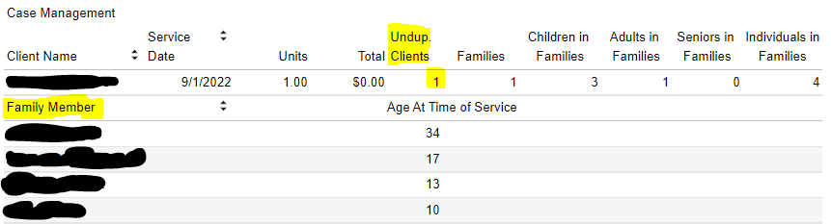
Public Input Period
Caseload: HOH or Family
Should reports pull in all services provided to all clients, including family members, or only the head of household?
  Currently data is entered on the Head of Household
  On the Service Summary report, household members are included in separate columns, but not included in the total for unduplicated services
Notes:
Presenter: Brittney -Yield time to Chair -Chair offers speakers 2 minutes each
Next Slide: Wyatt

Slide 22
Committee Debate
Caseload: HOH or Family
Notes:
Presenter: Wyatt -Committee members present 2 minutes each
Next Slide: Brittney (Record Delete Authorization explanation)

Slide 23
Public Input Period
Record Delete Authorization
Currently, only HMIS Admins can delete data records
  Records are deleted if they are requested by a user who can verify that it is incorrect data
  Types of records that are commonly deleted are: enrollments, services, client files, case notes
Delete Rights could be granted to the following three “levels”:
  Users (can delete anything created under their Organization)
  Agency Liaisons (can delete anything created under their organization)
  Admins (Can delete anything)
Notes:
Presenter: Brittney -Yield time to Chair -Chair authorizes each speaker 2 minutes
Next Slide: Wyatt

Slide 24
Committee Debate
Record Delete Authorization
Notes:
Presenter: Wyatt -Committee members present up to 2 minutes each
Next Slide: Wyatt

Slide 25
Committee Roll-Call Vote
HMIS Committee Officers
Notes:
Presenter: Wyatt
Next Slide: Wyatt

Slide 26
HMIS Advisory Committee
Annual Elections
Chair:
  Wyatt Haro
  No opponent
Vice Chair:
  No Nominations
Secretary/Recorder:
  No Nominations
Notes:
Presenter: Wyatt -Yield to HMIS Team Liaison to conduct Roll Call Vote for Chair -Yield time to Chair
Next Slide: Wyatt

Slide 27
Committee Roll-Call Vote
HMIS Committee Charter
Amendment 1
Notes:
Presenter: Wyatt -Final draft of Amendment 1
Next Slide: Wyatt

Slide 28
Committee Roll-Call Vote
Caseload - HOH v. Family
Notes:
Presenter: Wyatt -Roll Call Vote HOH OR FAMILY
Next Slide: Wyatt

Slide 29
Committee Roll-Call Vote
Record Deletion Authority
Notes:
Presenter: Wyatt -Roll Call Vote User authorization for ________ | Program Manager/Liaison authorization for _______
Next Slide: Wyatt

Slide 30
Committee Roll-Call Vote
Any other motion before committee
Notes:
Presenter: Wyatt -Open to motions by committee members -Transition Updates
Next Slide: Brittney

Slide 31
HMIS Q&A and Transition Updates
Self Sufficiency Matrix, Coordinated Entry, Enhancement Ideas
Notes:
Presenter: Brittney
Next slide: Brittney

Slide 32
System News
1) Recently we have been receiving quite a few tickets that are just replies to an old ticket. This may seem harmless but this is actually causing issues for the HMIS Admin team. We need to track each ticket separately and when there are replies to tickets with completely separate issues we are not able to properly track the corresponding work that goes into resolving the issue. With this being said we are asking that everyone please create a new ticket for each separate request that you have. Failure to comply with the above will result in a notifying response followed by the ticket being closed.
2) We have discovered numerous client accounts being created in the training site with live client data. Upon discovery any client data found in the training account will be removed after 3 days. We will send an email to both the violating user and the Agency Liaison notifying them upon discovery so that you will be able to get the proper information into the live site.This is against HMIS Policy and may result in training account suspension for the violating user(s).
Notes:
Presenter: Brittney
Next Slide: Brittney

Slide 33
Transition Updates
Self Sufficiency Matrix data import
  This is in progress with Eccovia - date TBD
Missing Services from ServicePoint
  This is in progress with Eccovia - date TBD
Coordinated Entry - Access Points
  Training on Coordinated Entry now available
    Access and Assessment, Kieara Gaskin
    Reach out to access@hsncfl.org if interested in becoming an Access Point and participating in Coordinated Entry
    Next training date: Sept 22nd, 10am-3pm
Enhancing the User Experience
  What are some suggestions of resources or features that would enhance the user experience in ClientTrack?
Notes:
Presenter: Brittney
Next Slide: Wyatt

Slide 34
HMIS Advisory Committee Nominees
Accepting nominations (from supervisors, liaisons, peers, and self)
  Email hmis-advisory@hsncfl.org
    Include
      Name
      Agency
      Role with HMIS
      How long you have worked in HMIS
      Contact Email
      Contact Telephone Number
      Brief Biography
Voting on nominations will be done virtually
Please be sure that any person nominated is able to commit time to the committee and is willing to participate
Notes:
Presenter: Wyatt
Next Slide: Wyatt

Slide 35
HSN HMIS Team
Angel Jones
HMIS Operations Manager
Agustin “Tino” Paz
HMIS Senior Data Analyst
Ashley Brozenske
HMIS Data Analyst I
Brittney Behr
HMIS Project Coordinator
Chuck Vroman
HMIS System Success Specialist
Racquel McGlashen
HMIS Partner Success Specialist
Tyler Claitt
HMIS Partner Support Specialist

Slide 36
Thank you for Attending!
Next meeting date:
Tuesday, November 8, 2022
10:30 am to 12:00 pm
Final meeting of 2022
HMIS Guides, Documents, Training, Acronyms & More
hmiscfl.org
https://www.hmiscfl.org/training/datadefinitions/
Notes:
Wyatt Closes Meeting

