Slide 1
HMIS Advisory Committee
FL-507 Continuum of Care
January 14, 2020

Slide 2
Agenda
Introductions (5 mins)
HMIS Policy & Procedures (30 mins)
  Advisory Committee structure
  HMIS Participation Requirements (was HMIS Inclusion/Exclusion Policy)
Official HUD Reports (5 mins)
System Performance Measures (10 mins)
  SPM - Agency Engagement
HMIS Training & Support (5 mins)
HMIS Software Review (5 mins)
Questions and New Topics/Issues

Slide 3
Introductions
Your Name
Your Agency
Have you been involved with the Point-In-Time count in the past? If so, what went well and what might be improved?

Slide 4
HMIS Policy & Procedures
New Items:
HMIS Participation Requirements (was “HMIS Inclusion/Exclusion Policy)( 10 mins)
Update on Previous Items:
HMIS Advisory Committee Structure (10 mins)
HUD Requirements
Notes:
Meeting Objective:
Action suggestion:

Slide 5
HMIS Advisory Committee Structure
Committee Officers
  Nominations
Membership requirements
  Representation by jurisdictions, project types, funding sources
Meeting processes (i.e., Robert Rules of Order)
Formal Tasks
  Evaluation; review new HMIS applications; etc.
HMIS Policy & Procedures
Notes:
Meeting’s Objective: to emphasize the importance of building up additional support resources directed specifically for HMIS Agency Liaisons.
Action suggestion: (maybe use a short paper survey?) discussion about how they understand the role of Agency Liaison and what kind of support they would like/need for specific topics/issues.

Slide 6
HMIS Participation Requirements
(was HMIS Inclusion/Exclusion Policy)
Review HMIS Participation Requirements
Develop Application Process
  Preliminary Interview
  Role of the HMIS Advisory Committee
Review Appeal Process
HMIS Policy & Procedures
Notes:
Meeting’s Objective: to emphasize the importance of building up additional support resources directed specifically for HMIS Agency Administrator.
Action suggestion: (maybe use a short paper survey?) discussion about how they understand the role of Agency Liaison and what kind of support they would like/need for specific topics/issues.

Slide 7
Official HUD Reports
Next Due Date for Submission:
System Performance Measures (SysPM): due by February 28, 2020 @ 8p.m.
Point-In-Time (PIT): due by April 30, 2020
Housing Inventory Count (HIC): due by April 30, 2020
Notes:
Meeting Objective: introduce topics for today’s 15 minutes time for this SECTION (Offical HUD Reports)
LSA: HUD extending deadline, waiting for vendors to implement various fixes.
PIT/HIC: Due at the end of April.

Slide 8
SPM Validation with Providers
Communications about how to review project data quality and time-frame in which to issue corrections sent to relevant Agency Liaisons on Dec. 31st
  Specific focus on making sure enrolled clients are active and up-to-date in the project
Date that final review of project-level data will be complete: January 31st
Final submission of SPM data to HUD: February 28th

Slide 9
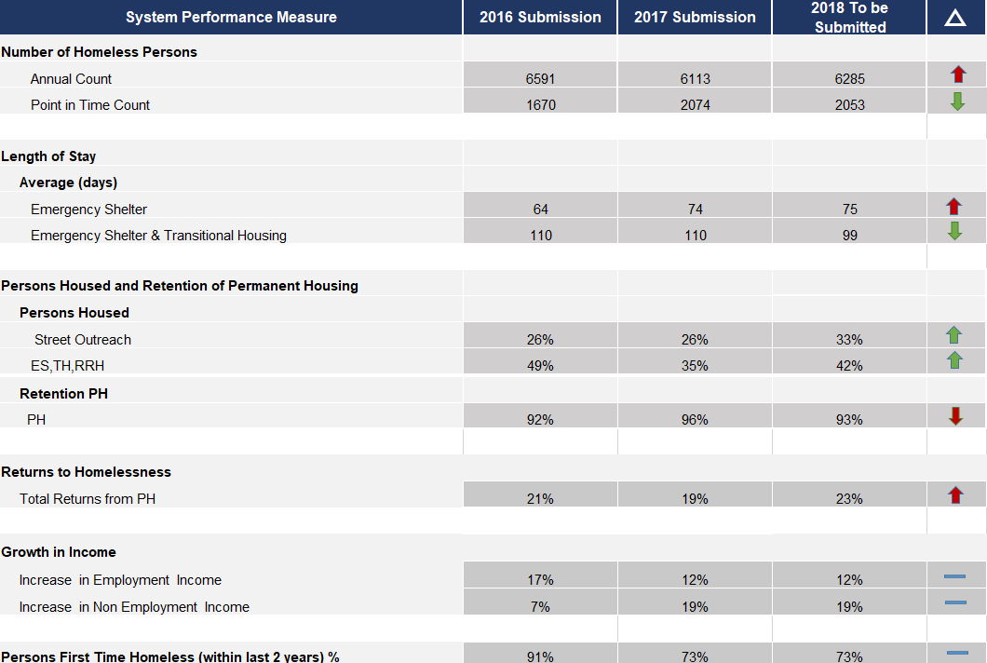

Slide 10

HMIS Training & Support
Regular Monthly Training Opportunities
See current dates at hmiscfl.org/training
New User Training
Refresher Training
Agency Liaison Training
  Housing Inventory Count (HIC)
Reporting Training
  Data Quality & Performance
Other topics
  New LMS Courses Avail! - HUD UDEs/DQ
Notes:
Meeting’s Objective: to promote the use of the HMIS web site as the “go to resource” for learning about and interacting with the HMIS Lead Agency for the FL-507
Action suggestion: request that meeting attendees submit one suggestion and/or comment (using the [SUPPORT] button) either:
about something that you liked and found useful from the web site or
about something that you don’t understand and couldn’t easily find on the web site

Slide 11
HMIS Software Review
ON HOLD - HUD is recommending that communities NOT transition at this time.
Next steps: TBD
Notes:
Meeting’s Objective: to present the Software Review process as an official requirement which takes time and effort to understand how the functional requirements of HMIS are implemented in difference software. Today we want to begin gathering feedback and input from current HMIS users.
Action suggestion: Pass out Rating Tool. Ask the participants to submit their input via the [SUPPORT] (maybe also add “Software Review” a topic option in ZenDesk?) or by completing Angel’s paper survey.

Slide 12
Questions or
New Topics and Issues
Next meeting date:
Tuesday, March 14, 2019
10:30 am to 12:00 pm

Slide 13
HSN HMIS Team
Agustin “Tino” Paz
HMIS Operations Manager
Angel Jones
HMIS Partner Success Manager
Brittney Behr
HMIS Data Analyst
Chuck Vroman
HMIS System Success Specialist
Racquel McGlashen
HMIS Partner Success Specialist

