Slide 1
HMIS Advisory Committee
FL-507 Continuum of Care
May 20, 2019

Slide 2
Agenda
Introductions (10 mins)
HMIS Policy & Procedures (10 mins)
Official HUD Reports (10 mins)
System Performance Measures (10 mins)
HMIS Training & Support (5 mins)
HMIS Software Review (5 mins)
Questions and New Topics/Issues

Slide 3
Introductions
Your Name
Your Agency
From your perspective, what is the most important data element in HMIS? (No right or wrong answer!)

Slide 4
HMIS Policy & Procedures
Agency/Project Renaming (5 mins)
HMIS User Subscriptions (5 mins)
Changes to HMIS Agency Administrators role assignments (5 mins)
HUD Requirements
Notes:
Meeting Objective: introduce topics for today’s 15 minutes time for this SECTION (HMIS Policy & Procedures)

Slide 5
Agency/Project Renaming
Consistent Naming for All Projects
  Agency [Dept.]-Project Name:Project Type
EDA Value is NOT Affected
  Searching by EDA unaffected
Reporting is NOT Affected (APR, CAPER, etc.)
  Reporting groups unaffected
HMIS Policy & Procedures
Notes:
Meeting’s Objective: Information and prep for future discussions
Action suggestion: ???
All of us play important roles in the CoC efforts to end homelessness. The primary function and objective of HMIS is to systematically document the work of defined projects with specific populations to improve their housing situation.
The responsibilities of the HMIS Advisory Committee is to understand the necessary requirements and guide and monitor their effective and successful implementation, including:
a) to develop appropriate and effective operational policies and procedures,
b) to help identify different training and support needs for different audiences (Users, Agency Admins, Executive Directors, Board Members, Funders, and the media and general public),
c) to improve the understanding and use of HMIS data, especially as presented in Official HUD Reports
d) to promote the practice of being data-driven decision-makers

Slide 6
HMIS User Subscriptions
The HUD CoC grant for HMIS is static and doesn’t cover all the costs associated with implementing and maintaining HMIS.
Agencies using HMIS are not the same and HMIS User Subscriptions need to be as equitable as possible for both small, medium & large agencies.
CoC FL-507 / HSN HMIS User Subscriptions
HMIS Policy & Procedures

Slide 7
Changes to HMIS Agency Administration
ServicePoint Role Assignment
With the new password reset functionality, there is no longer a need for local users with Agency Admin rights in ServicePoint.
Agency Admin rights are very complicated and rarely, if ever, needed other than for password resets.
If situations occur that warrant assigning Agency Admin rights, they will be evaluated on a case by case basis.
Moving forward we will refer to “HMIS Agency Liaison” instead of Agency Admins.
HMIS Policy & Procedures
Notes:
Meeting’s Objective: to emphasize the importance of building up additional support resources directed specifically for HMIS Agency Administrator.
Action suggestion: (maybe use a short paper survey?) discussion about how they understand the role of Agency Administrator and what kind of support they would like/need for specific topics/issues.

Slide 8
Responsibilities of a
HMIS Agency Liaison
  Understand the basic project descriptors of all active agency projects using HMIS
  Provide first-line support and guidance to your agency’s HMIS users
  Communicate regularly with HSN’s HMIS teams when changes occur to projects/users
  Know how to run and use needed reports for monitoring performance and data quality
HMIS Policy & Procedures
Notes:
Meeting’s Objective: to emphasize the importance of building up additional support resources directed specifically for HMIS Agency Administrator.
Action suggestion: (maybe use a short paper survey?) discussion about how they understand the role of Agency Liaison and what kind of support they would like/need for specific topics/issues.

Slide 9
Official HUD Reports
Current Active Reports:
  Longitudinal System Analysis (LSA)
  System Performance Measures (SysPM)
Recently Submitted Reports:
  Point-In-Time (PIT)
  Housing Inventory Count (HIC)
Notes:
Meeting Objective: introduce topics for today’s 15 minutes time for this SECTION (Offical HUD Reports)
LSA: HUD extending deadline, waiting for vendors to implement various fixes.
PIT/HIC: Due at the end of April.

Slide 10
System Performance Measures
System Performance Measures Video Series
  System Performance Measure #1: Length of Time Persons Remain Homeless
Notes:
Meeting’s Objective: to practice using the SPM data points to raise questions about short- and long-term trends and needed course corrections throughout the year.
Action suggestion: HOMEWORK ASSIGNMENT: select one of the SPM Videos to watch before the next HAC mtg for discussion.

Slide 11
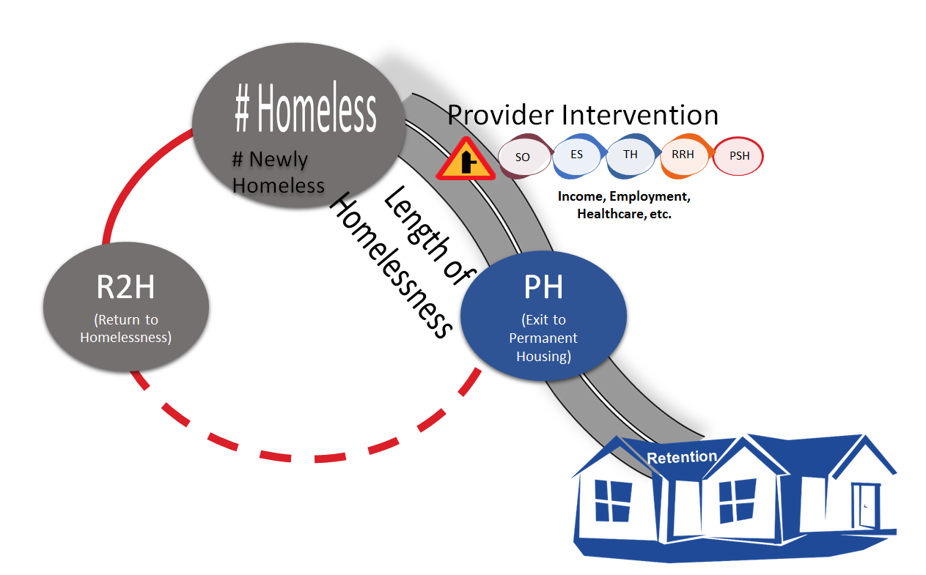
No one measure by itself tells the whole story!
System Performance Measures
Notes:
Meeting’s Objective: to promote and practice the use of a meaningful story narrative to help understand and disseminate SPM data.
Action suggestion: HOMEWORK ASSIGNMENT: How many of the SPM data point can you track using the FL-507 Community Dashboard? How would that work?

Slide 12

HMIS Training & Support
Current Training Schedule & Opportunities
  Refresher Training: Monthly on 2nd Mon. - 06/10/19
  Agency Liaison Training: TBD
  Reporting Training: June 18th, 2019
    Data Quality
    Performance
  Other topics
    New LMS Courses Avail! - HUD UDEs/DQ
    Upcoming Courses - Reporting series
Notes:
Meeting’s Objective: to promote the use of the HMIS web site as the “go to resource” for learning about and interacting with the HMIS Lead Agency for the FL-507
Action suggestion: request that meeting attendees submit one suggestion and/or comment (using the [SUPPORT] button) either:
about something that you liked and found useful from the web site or
about something that you don’t understand and couldn’t easily find on the web site

Slide 13
HMIS Software Review
Why are we reviewing other vendor software?
  It is our responsibility to make sure the vendor is fulfilling the roles & responsibilities required by the CoC FL-507.
What are Request for Proposals (RFP)?
  A document that describes a project’s needs and asks for proposed solutions from qualified vendors.
Where do we go to look at the submitted RFP’s & download vendor checklist?
  https://www.hmiscfl.org/hmis-advisory-committee/
  Code: HMISCoCFL-507
Notes:
Meeting’s Objective: to present the Software Review process as an official requirement which takes time and effort to understand how the functional requirements of HMIS are implemented in difference software. Today we want to begin gathering feedback and input from current HMIS users.
Action suggestion: Ask the participants to submit their input via the [SUPPORT] (maybe also add “Software Review” a topic option in ZenDesk?) or by completing Angel’s paper survey.

Slide 14
Questions or
New Topics and Issues
Next meeting date:
Tuesday, July 16, 2019
10:30 am to 12:00 pm

Slide 15
HSN HMIS Team
Agustin “Tino” Paz
HMIS Operations Manager
Angel Jones
HMIS Partner Success Manager
Chuck Vroman
HMIS System Success Specialist
Racquel McGlashen (new)
HMIS Partner Success Specialist

