Slide 1
HMIS Advisory Committee
FL-507 Continuum of Care
September 10, 2019

Slide 2
Agenda
Introductions (5 mins)
HMIS Policy & Procedures (30 mins)
Official HUD Reports (5 mins)
System Performance Measures (10 mins)
HMIS Training & Support (5 mins)
HMIS Software Review (5 mins)
Questions and New Topics/Issues

Slide 3
Introductions
Your Name
Your Agency
How frequently do you visit the HUD Exchange resources for HMIS?
    Daily
    Weekly
    Monthly
    Never
    What’s HUD Exchange?
Additional questions:
Why did you visit?
Did you find what you were looking for?
What keeps you from using the HUD Exchange more?

Slide 4
HMIS Policy & Procedures
2020 HMIS Data Standards
HMIS Agency Liaisons status (3 mins)
HMIS Advisory Committee structure (15 mins)
HMIS User Subscriptions (3 mins)
Business Associate Agreements (BAA) under review
HUD Requirements
Notes:
Meeting Objective:
Action suggestion:

Slide 5
HMIS Agency Liaison
29 Users have attended AL Training
Feedback has been very positive
HMIS Agency Liaison training available on a monthly basis
How formal should the requirements associated with HMIS Agency Liaison be? (This question moves us into the next topic.)
HMIS Policy & Procedures
Notes:
Meeting’s Objective: to emphasize the importance of building up additional support resources directed specifically for HMIS Agency Administrator.
Action suggestion: (maybe use a short paper survey?) discussion about how they understand the role of Agency Liaison and what kind of support they would like/need for specific topics/issues.

Slide 6
HMIS Advisory Committee Structure
Committee Officers
  Nominations
Membership requirements
  Representation by jurisdictions, project types, funding sources
Meeting processes (i.e., Robert Rules of Order)
Formal Tasks
  Evaluation; review new HMIS applications; etc.
HMIS Policy & Procedures
Notes:
Meeting’s Objective: to emphasize the importance of building up additional support resources directed specifically for HMIS Agency Liaisons.
Action suggestion: (maybe use a short paper survey?) discussion about how they understand the role of Agency Liaison and what kind of support they would like/need for specific topics/issues.

Slide 7
HMIS Advisory Committee Structure
Next Steps:
Further discussion (before Sept meeting):
  Develop Recommendations (GoToMeeting)
  Prepare/refine Recommendations (GoToMeeting)
Final proposal for FL-507 CoC Board Approval will be discussed at September meeting
HMIS Policy & Procedures
Notes:
Meeting’s Objective: to emphasize the importance of building up additional support resources directed specifically for HMIS Agency Liaisons.
Action suggestion: (maybe use a short paper survey?) discussion about how they understand the role of Agency Liaison and what kind of support they would like/need for specific topics/issues.

Slide 8
Official HUD Reports
Recently Submitted Reports:
HDX HMIS Report for NOFA and other reports (i.e., Racial Disparities - for FY17-18)
Longitudinal System Analysis (LSA)
  Introducing “Stella”
System Performance Measures (SysPM)
Point-In-Time (PIT)
Housing Inventory Count (HIC)
Notes:
Meeting Objective: introduce topics for today’s 15 minutes time for this SECTION (Offical HUD Reports)
LSA: HUD extending deadline, waiting for vendors to implement various fixes.
PIT/HIC: Due at the end of April.

Slide 9
Official HUD Reports
Project-Based Reports Coming Due Soon:
ESG CAPER
Email will go out to all ESG projects for technical support as needed
Notes:
Meeting Objective: introduce topics for today’s 15 minutes time for this SECTION (Official HUD Reports)
LSA: HUD extending deadline, waiting for vendors to implement various fixes.
PIT/HIC: Due at the end of April.

Slide 10
System Performance Measures
System Performance Measures Video Series
  System Performance Measure #3: Number of Homeless Persons
Notes:
Meeting’s Objective: to practice using the SPM data points to raise questions about short- and long-term trends and needed course corrections throughout the year.
Action suggestion: HOMEWORK ASSIGNMENT: select one of the SPM Videos to watch before the next HAC mtg for discussion.

Slide 11
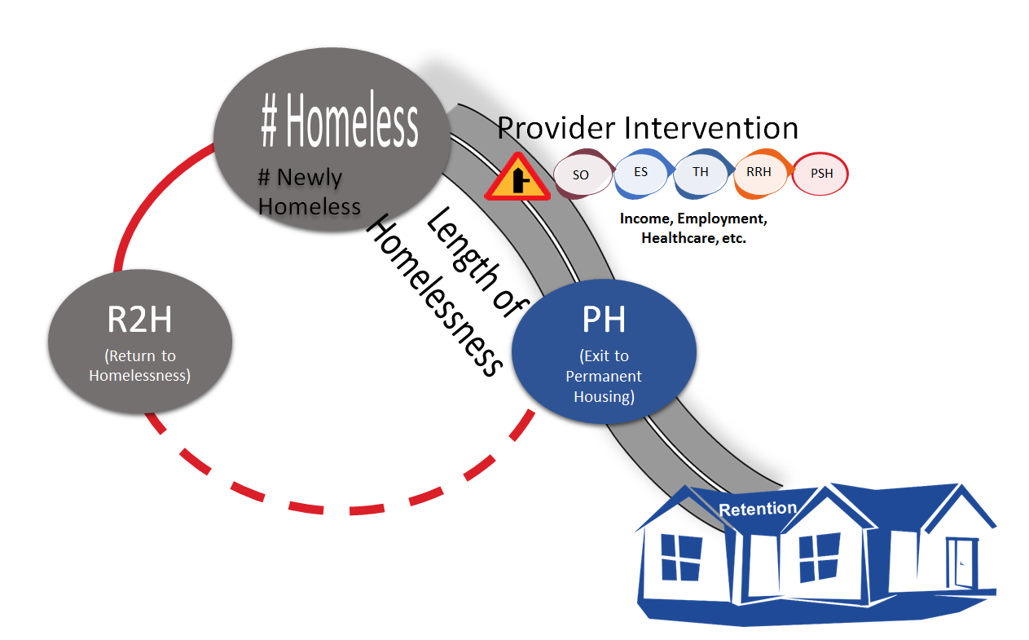
No one measure by itself tells the whole story!
System Performance Measures
Notes:
Meeting’s Objective: to promote and practice the use of a meaningful story narrative to help understand and disseminate SPM data.
Action suggestion: HOMEWORK ASSIGNMENT: How many of the SPM data point can you track using the FL-507 Community Dashboard? How would that work?

Slide 12

HMIS Training & Support
Regular Monthly Training Opportunities
See current dates at hmiscfl.org/training
New User Training
Refresher Training
Agency Liaison Training
Reporting Training
  Data Quality & Performance
Other topics
  New LMS Courses Avail! - HUD UDEs/DQ
  Upcoming Courses - Reporting series
Notes:
Meeting’s Objective: to promote the use of the HMIS web site as the “go to resource” for learning about and interacting with the HMIS Lead Agency for the FL-507
Action suggestion: request that meeting attendees submit one suggestion and/or comment (using the [SUPPORT] button) either:
about something that you liked and found useful from the web site or
about something that you don’t understand and couldn’t easily find on the web site

Slide 13
HMIS Training & Support
Special Focus Topics:
  Upcoming Courses:
    Annual Assessments
    Housing Move-in Date
    Duplicate Management
  2020 HUD Data Updates - Webinar
    September 26, 10 a.m. to 11 a.m
Notes:
Meeting’s Objective: to promote the use of the HMIS web site as the “go to resource” for learning about and interacting with the HMIS Lead Agency for the FL-507
Action suggestion: request that meeting attendees submit one suggestion and/or comment (using the [SUPPORT] button) either:
about something that you liked and found useful from the web site or
about something that you don’t understand and couldn’t easily find on the web site

Slide 14
HMIS Software Review
Next steps:
Create Ad-hoc committee?
Authorize staff to select XX options
Schedule Software Reviews for CoC?
Notes:
Meeting’s Objective: to present the Software Review process as an official requirement which takes time and effort to understand how the functional requirements of HMIS are implemented in difference software. Today we want to begin gathering feedback and input from current HMIS users.
Action suggestion: Ask the participants to submit their input via the [SUPPORT] (maybe also add “Software Review” a topic option in ZenDesk?) or by completing Angel’s paper survey.

Slide 15
Questions or
New Topics and Issues
Next meeting date:
Tuesday, November 19, 2019
10:30 am to 12:00 pm

Slide 16
HSN HMIS Team
Agustin “Tino” Paz
HMIS Operations Manager
Angel Jones
HMIS Partner Success Manager
Brittney Behr
HMIS Data Analyst
Chuck Vroman
HMIS System Success Specialist
Racquel McGlashen
HMIS Partner Success Specialist

